Slide 1

Costumer Churn Prediction
Soham Sharma
(data analyst intern)

Slide 2
Customer Churn Prediction
Objective:
Customer churn prediction aims to identify customers likely to stop using a product or service. Businesses often lose a significant portion of revenue due to churn, so predicting and preventing it is essential for customer retention strategies. In this report, we’ll explore the concept, methodology, and practical example of customer churn prediction in a telecom industry context.
Introduction to Customer Churn:
Customer churn, or customer attrition, refers to the loss of clients or customers. It can be calculated over a specific time period, often as a percentage of customers who stopped using the service compared to the total number of customers.
Types of Customer Churn:
Voluntary Churn: When a customer chooses to leave (e.g., switching to a competitor).
Involuntary Churn: When a customer is lost due to circumstances beyond their control, such as failed payments or account issues.

Slide 3
Business Impact of Customer Churn
High churn rates can lead to:
Revenue Loss: Losing customers directly impacts the bottom line, reducing revenue and profit.
High Acquisition Costs: It often costs more to acquire new customers than to retain existing ones.
Brand Damage: High churn rates can indicate customer dissatisfaction, potentially harming the brand’s reputation.
Churn Prediction Model:
Telecom Industry Example In the telecom industry, churn prediction is especially relevant due to the high competition and availability of alternative service providers. Telecom companies aim to reduce churn by predicting which customers are most likely to leave and offering targeted retention programs.
Example : A telecom company wants to predict whether a customer is likely to churn in the next month, based on customer data like monthly charges, tenure, and contract type.

Slide 4
Methodology
Data Collection: Collect historical customer data, including:
Customer Demographics: Age, gender, and location.
Account Information: Tenure, contract type (e.g., monthly or yearly), and payment method.
Service Usage: Types of services used (e.g., internet, phone), number of calls, data usage.Billing
Information: Monthly charges, total charges, and past payment history.
Data Preprocessing: Cleaning and preparing the data for modeling:
Handle Missing Values: Fill or drop missing values as necessary.
Convert Categorical Data: Use encoding techniques for categorical features.
Feature Scaling: Standardize or normalize numerical features.
Feature Engineering: Create new features if relevant, such as average charges over tenure.

Slide 5
Model Selection: Choose appropriate machine learning algorithms:
Logistic Regression: Suitable for binary classification and interpretable.
Decision Trees and Random Forests: Effective in capturing nonlinear relationships and interactions between variables.
Support Vector Machines (SVM): Effective for high-dimensional data.
Neural Networks: Suitable for capturing complex patterns, though harder to interpret.
Gradient Boosting (e.g., XGBoost): Known for high accuracy in structured data.
Model Training and Evaluation:
Split the Data: Divide data into training and testing sets, typically 70%-30% or 80%-20%.
Train the Model: Fit the model on the training dataset.
Evaluate the Model: Use metrics such as accuracy, precision, recall, F1-score, and Area Under the ROC Curve (AUC-ROC) to assess the model’s performance.
3. Threshold Tuning: Adjust the classification threshold to optimize for business needs, e.g., increasing recall to capture more potential churners.
4. Deployment and Monitoring: Deploy the model and monitor its performance over time, retraining as necessary to maintain accuracy with new data.

Slide 6
Interpretation of Model Metrics
Accuracy: Measures the proportion of correct predictions.
Precision: Indicates the proportion of true positives among predicted positives (e.g., predicted churners who actually churned).
Recall: Shows the proportion of true positives captured out of all actual positives.
F1 Score: The harmonic mean of precision and recall, useful for imbalanced classes.
ROC AUC: A high AUC score implies that the model distinguishes well between churners and non-churners.
Results and Business Actions
Suppose the model achieves an accuracy of 85%, precision of 80%, and recall of 75%. This result implies the model is reasonably effective in predicting churn, with a strong ability to capture most churners (high recall).

Slide 7
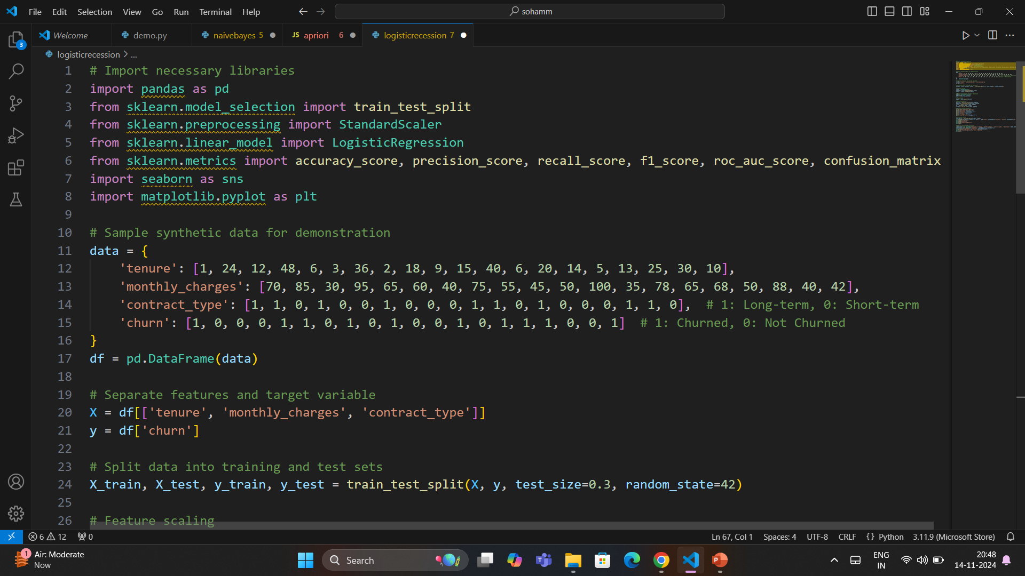

Slide 8
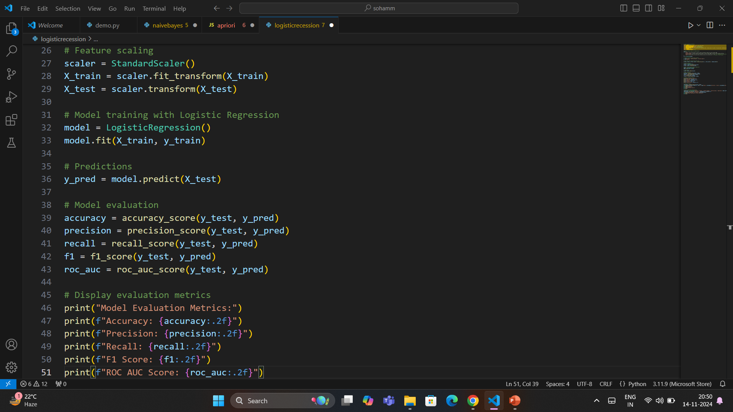

Slide 9
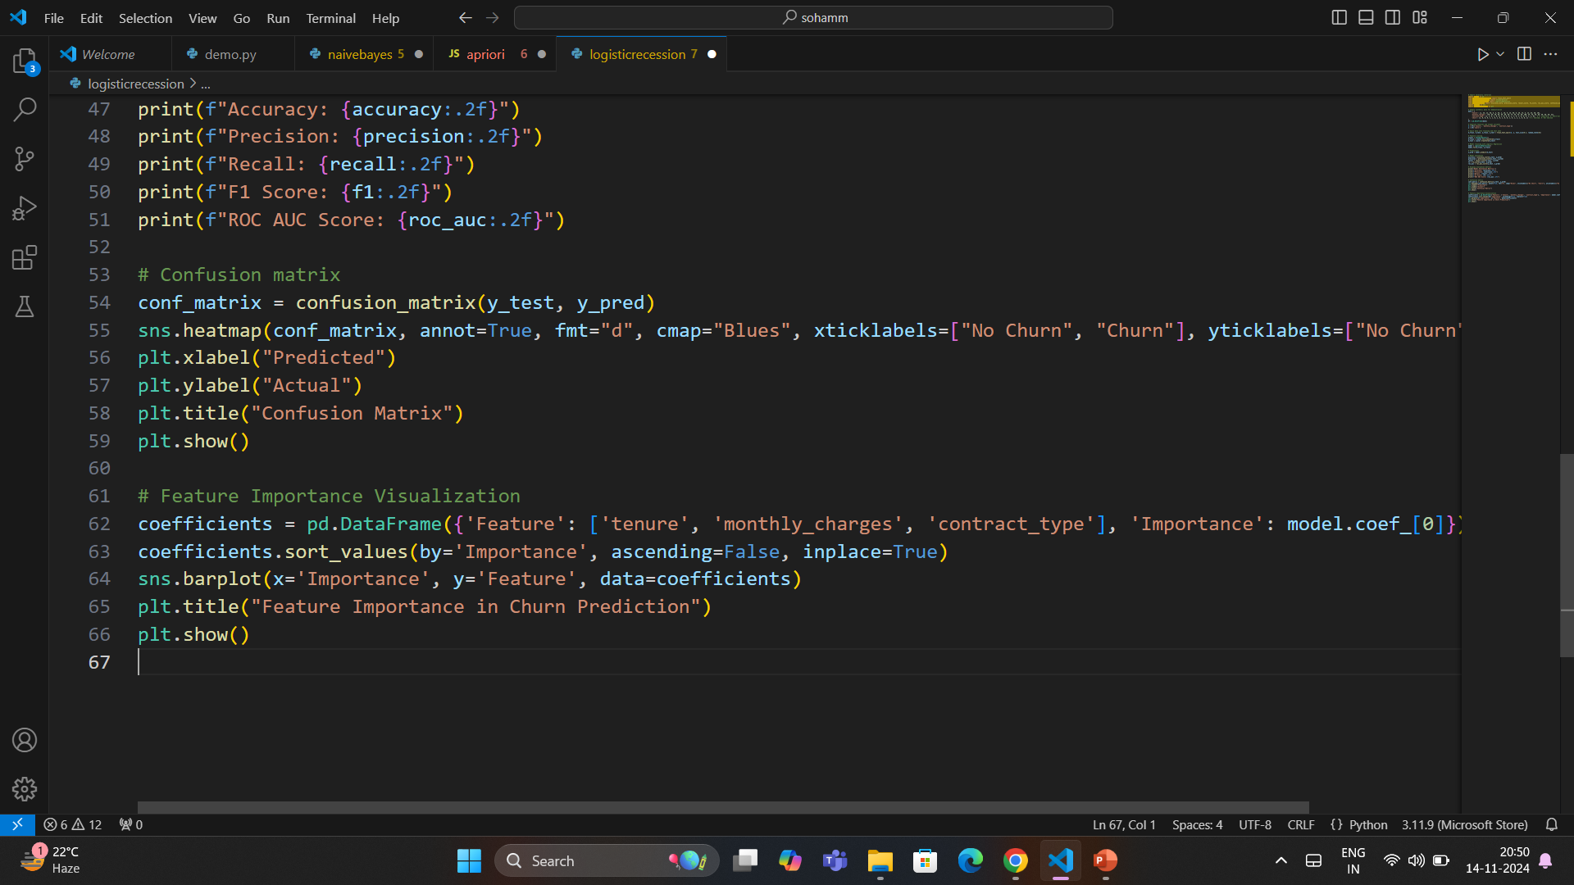

Slide 10
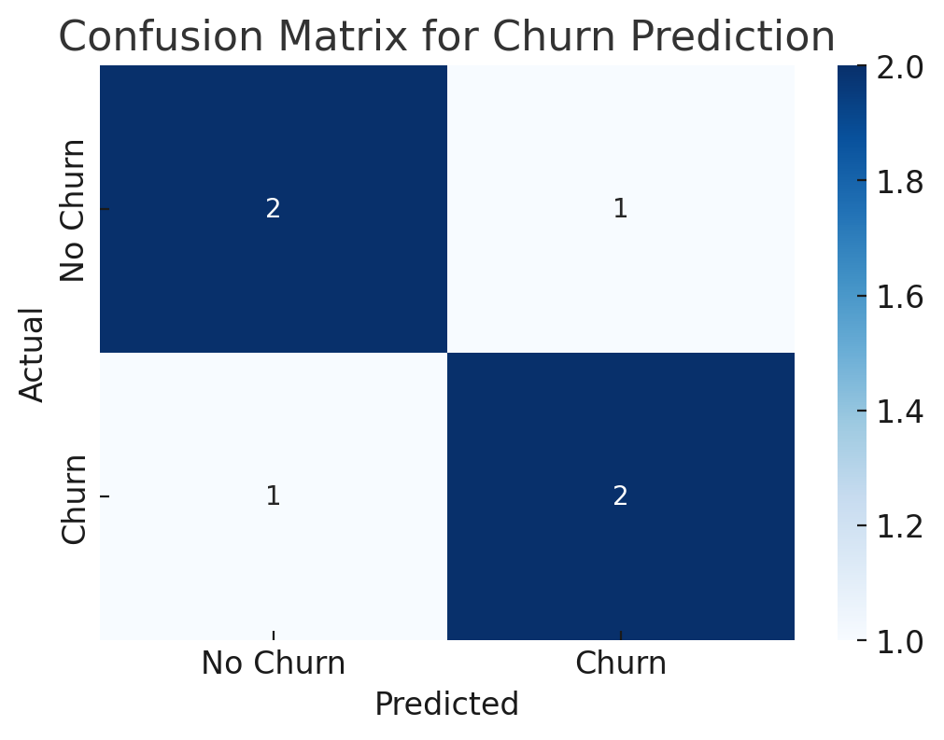
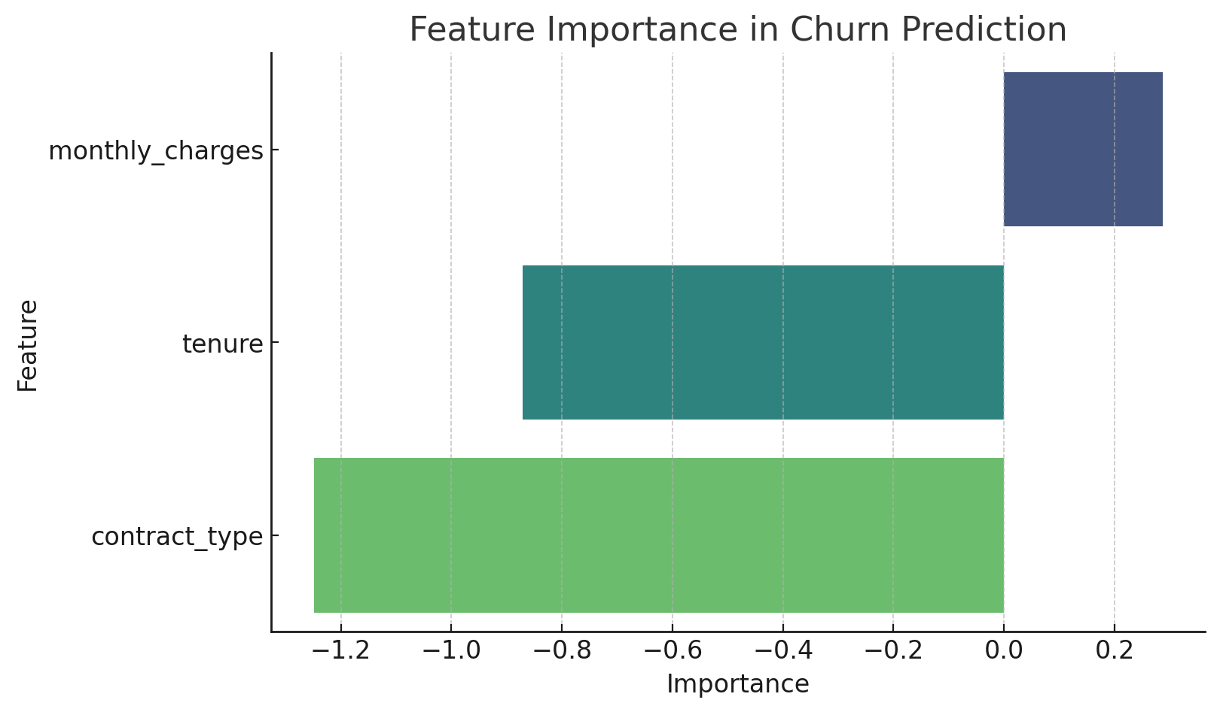
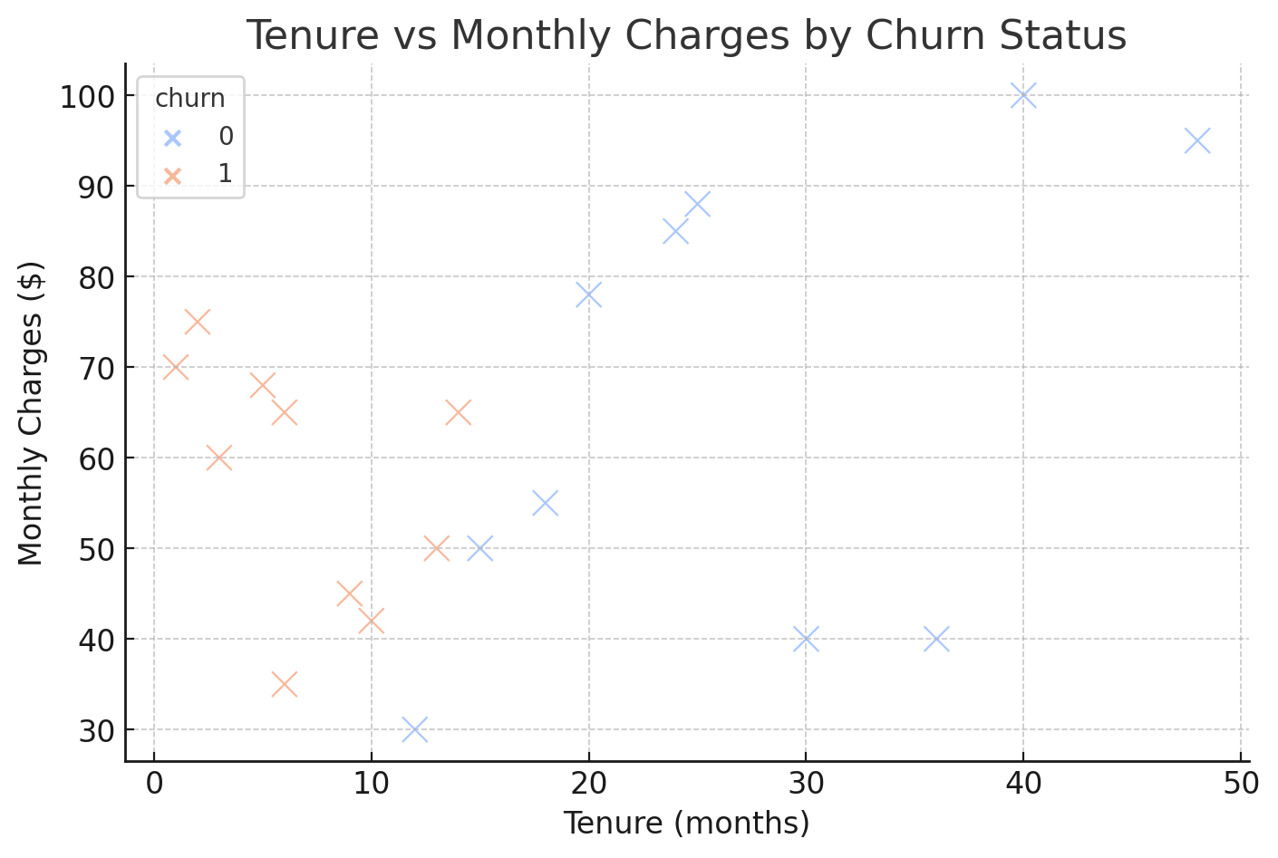
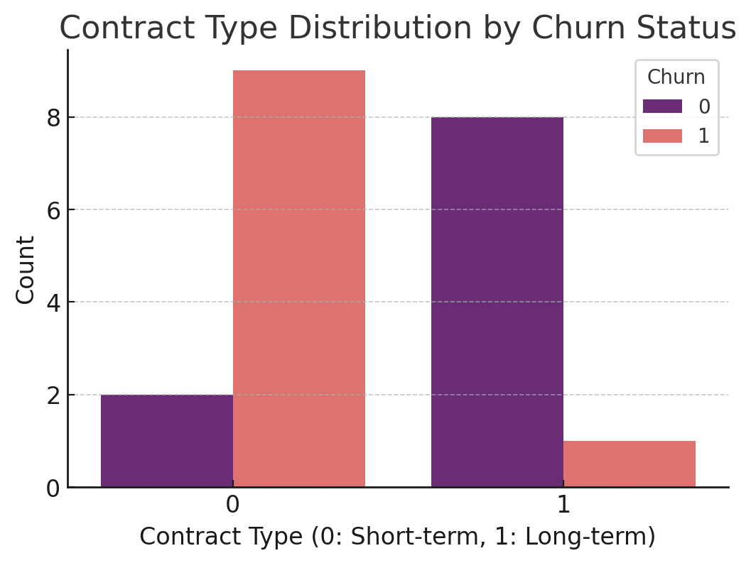

Slide 11
Potential Business Actions:
Targeted Retention Offers: Offer discounts or personalized plans to predicted churners.
Improved Customer Support: Reach out proactively to address issues that may lead to churn.
Service Optimization: Analyze churn reasons and adjust service quality or pricing strategies accordingly.
Conclusion
Customer churn prediction provides businesses with a powerful tool for enhancing customer retention strategies. By identifying potential churners early, companies can take proactive steps to reduce churn, improve customer satisfaction, and increase long-term profitability.

